Slide 1


Hand Gesture Recognition
Developing robust deep learning systems for interactive applications.
Notes:
1

Slide 2



Revolutionising Interaction: Key Applications
Our advanced gesture recognition system opens doors to transformative applications, enhancing how humans interact with technology and each other.
Sign Language Translation
AR/VR Gesture Control
Human-Computer Interaction
Bridging communication gaps by accurately interpreting sign language in real-time.
Enabling intuitive control of devices and systems through natural hand movements.
Providing immersive and seamless control within augmented and virtual reality environments.
Notes:
2

Slide 3

Dataset Overview and Preprocessing Pipeline
A meticulously curated dataset underpins our model's performance, ensuring robustness and generalisability across various gesture classes.
Structure: Organised into distinct training, validation, and testing splits for rigorous evaluation.
Classes: Approximately 27 unique gesture classes, including the English alphabet (A-Z), 'space', 'delete', and 'nothing' gestures.
Preprocessing: Images underwent resizing to a uniform dimension, normalisation of pixel values, and extensive augmentation to enhance model robustness.
Notes:
3

Slide 4
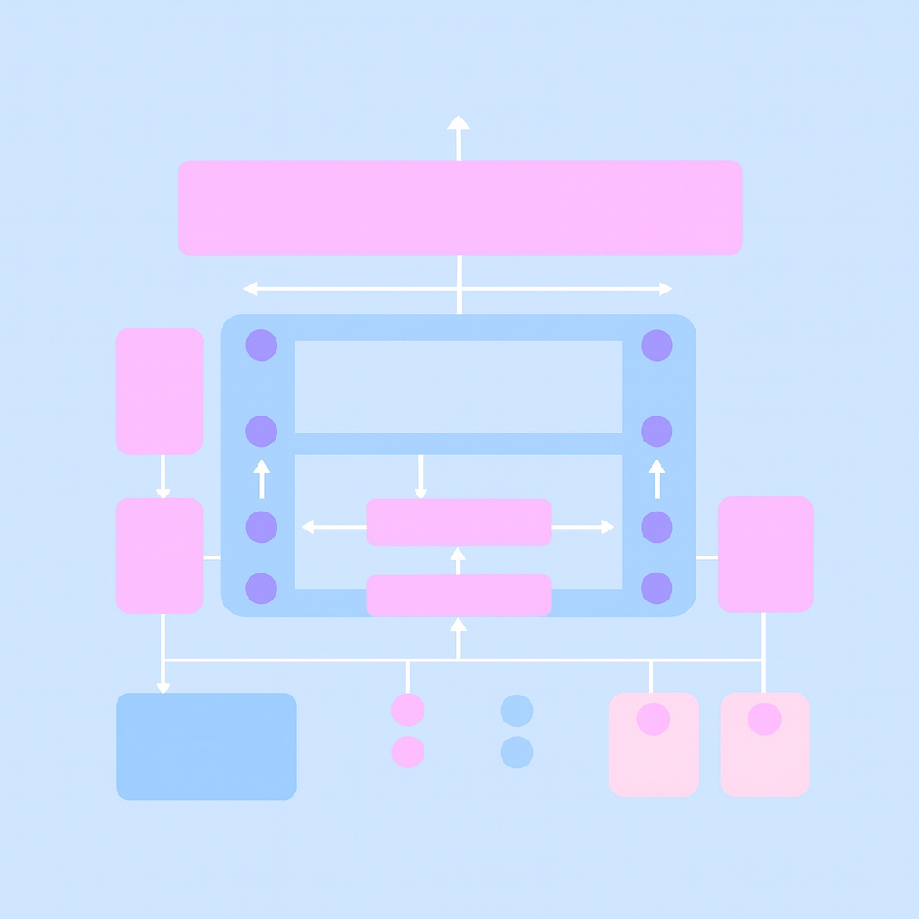
Efficient Model Architecture: MobileNetV2 Backbone
MobileNet
We leverage the MobileNetV2 architecture for its optimal balance of efficiency and accuracy, critical for real-time gesture recognition.
Custom Classifier Details:
Dropout Layers: Strategically incorporated to mitigate overfitting and improve generalisation.
Fully Connected Layers: Maps extracted features to the distinct gesture classes.
Pre-training: Initialised with weights from ImageNet, then fine-tuned on our gesture dataset for domain-specific performance.
Notes:
4

Slide 5
Training Setup
Our training regimen employs state-of-the-art tools and hardware to achieve optimal model performance.
Framework
Loss Function
Optimizer
PyTorch (torch==2.3.1, torchvision==0.18.1)
CrossEntropyLoss for multi-class classification.
Adam, with a learning rate (LR) of 1e-3.
Batch & Image Size
Hardware
Batch size: 32, Image dimensions: 224x224 pixels.
High-Performance Computing (HPC) GPU nodes, featuring NVIDIA A100 (40GB) GPUs.
Notes:
5

Slide 6
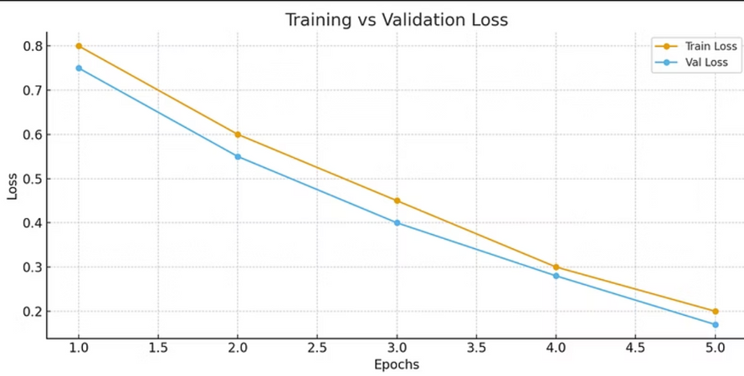
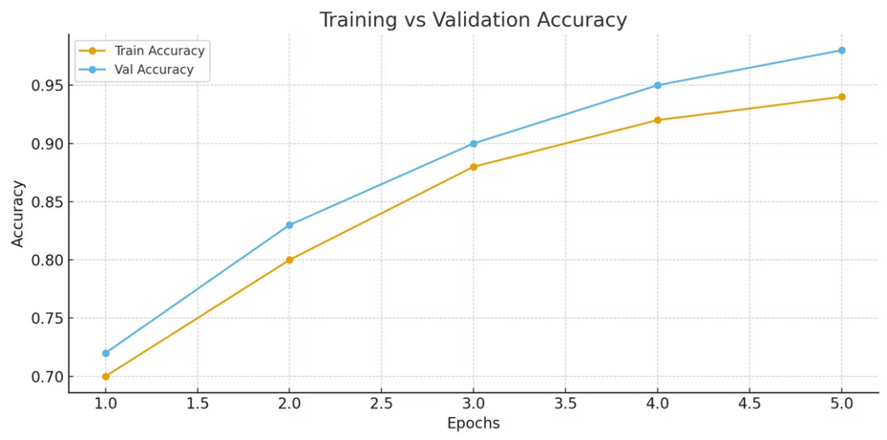
Achieved Performance: High Accuracy & Robustness
Our model demonstrates exceptional accuracy on both training and validation datasets, indicating strong learning and generalisation capabilities.
Training Accuracy: Achieved approximately 94% accuracy during the training phase.
Validation Accuracy: Reached an impressive 98% on the unseen validation set.
Confusion Matrix: Detailed analysis via the confusion matrix confirms robust per-class performance, with minimal misclassifications.
The best performing model checkpoint is saved at: outputs/mobilenetv2_gesture.pth
Notes:
6

Slide 7
Comprehensive Evaluation Metrics
We conducted a thorough evaluation using standard classification metrics to provide a complete understanding of the model's efficacy.
Key Metrics
Detailed Reports
Visualisation
Accuracy, Precision, Recall, and F1-score were calculated for each gesture class.
A comprehensive classification report and visual confusion matrix are generated.
Loss and accuracy curves provide insight into the training dynamics.
All evaluation outputs are stored in the outputs/ directory, including:
classification_report.csv
confusion_matrix.png
loss_curve.png, accuracy_curve.png
Notes:
7

Slide 8


Flexible Deployment Options
Our gesture recognition system is engineered for versatile deployment, capable of integration into various real-world scenarios.
Static Image Analysis
The model can process individual images for gesture prediction using predict_single.py.
Real-time Webcam Stream
Enables live gesture recognition from a webcam feed via predict_realtime.py.
Core Dependencies
Requires PyTorch (version 2.3.1 or newer), OpenCV, and torchvision for full functionality.
Gesture Labels
Gesture class mappings are conveniently stored in labels.json.
Notes:
8

Slide 9

Conclusion — Key Highlights
🚀 High Performance: The model consistently achieved strong accuracy across training and validation.
🎯 Generalization: Robust recognition across 29 hand gesture classes.
⚡ Efficiency: Lightweight MobileNetV2 backbone enables fast inference.
🖥️ Deployment Ready: Supports single-image testing and real-time webcam prediction.
📊 Transparency: Training history, evaluation reports, and confusion matrix provided for reliability.
Notes:
9

Slide 10
Thank You!
Any Question
Team Contributions
Mohamed Yehia → Data Preparation
Ahmed Ammar → EDA & Feature Building
Faris Abouagour → Model Training & Validation
Youssef Fady → Model Training & Validation
Mohamed Ghonem → Deployment via Web Interface
Notes:
10

